Slide 1
TELEMETRY AND TELEMETICS

Slide 2
TRANSPORTATION
Examples of transportation IoT include: More efficient, less costly mass transit, that employ networks of sensors, digital cameras, and communication systems to increase system capacity and enhance passenger safety and comfort while lowering costs and risks.

Slide 3
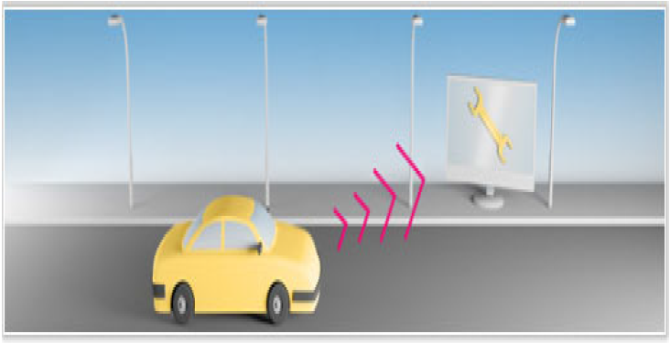

Slide 4
Inthe transportation industry, telemetry provides meaningful information about a vehicle or driver's performance by collecting data from sensors within the vehicle. This is undertaken for various reasons ranging from staff compliance monitoring, insurance rating to predictive maintenance.

Slide 5
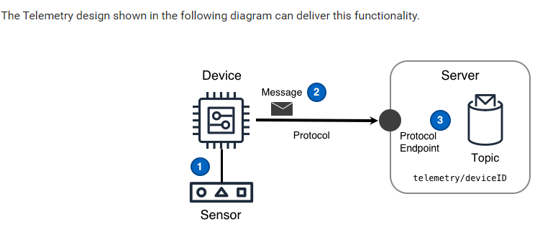

Slide 6
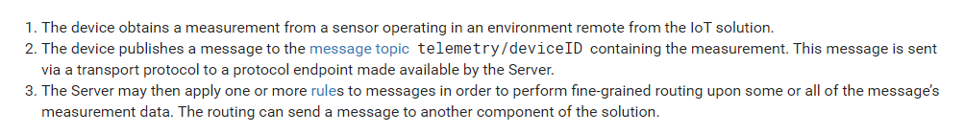

Slide 7
TELEMATICS
Telematics is an interdisciplinary field that encompasses telecommunications, vehicular technologies (road transport, road safety, etc.), electrical engineering (sensors, Instrumentation, wireless communications, etc.), and computer science (multimedia, Internet, etc.).

Slide 8
What are telematics in a car?
At its core, a telematics system includes a vehicle tracking device installed in a vehicle that allows the sending, receiving and storing of telemetry data. ... The telematics data captured can include location, speed, idling time, harsh acceleration or braking, fuel consumption, vehicle faults, and more.

Slide 9
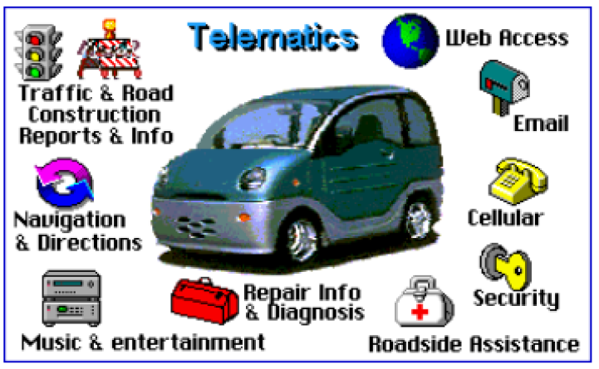

Slide 10
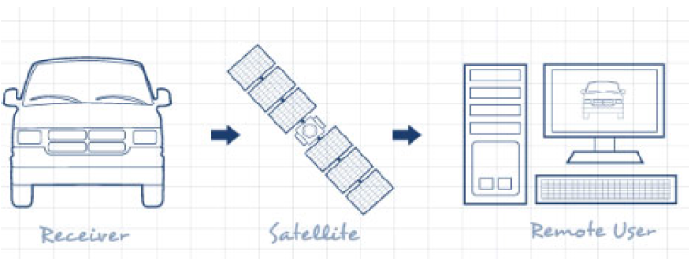

Slide 11
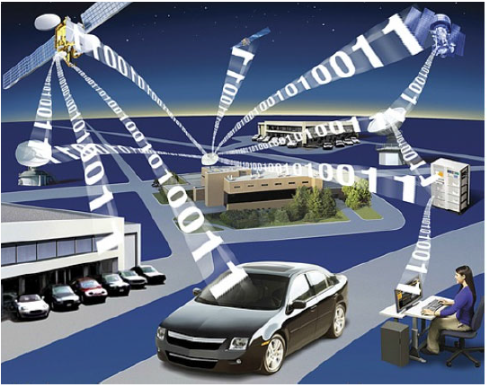
Telemetry and Telemetics

Slide 12
Telemetry and Telemetics
Telemetry is the highly automated communications process by which measurements are made and other data collected at remote or inaccessible points and transmitted to receiving equipment for monitoring.
Telematics is the convergence of telecommunications and information processing, the term later evolved to refer to automation in automobiles, such as the invention of the emergency warning system for vehicles. GPS navigation, integrated hands-free cell phones, wireless safety communications and automatic driving assistance systems all are covered under the telematics umbrella.

Slide 13
Monitoring the location, movements, status and behaviour of a vehicle/asset or fleet of vehicles/assets. This is achieved through a combination of a GPS receiver and an electronic device (usually comprising a GSM GPRS modem or SMS sender), communicating with the user (dispatching, emergency or co-ordinating unit) and web-based software. The data is turned into information by management reporting tools in conjunction with a visual display on computerised mapping software.

